Slide 1
CHAPTER FIVE
Integration

Slide 2
All graphics are attributed to:
Calculus,10/E by Howard Anton, Irl Bivens, and Stephen Davis Copyright © 2009 by John Wiley & Sons, Inc. All rights reserved.

Slide 3
Chapter Overview
In this chapter we will begin with the idea of what “area” means and we will study two approaches to defining and calculating areas.
After that, we will discuss the Fundamental Theorem of Calculus and how it relates tangent lines and areas.
Later, we will study more rectilinear motion (position, velocity, acceleration along an s-axis) and integrals involving logarithms.

Slide 4
The Rectangle Method for Finding Area
Divide the interval [a,b] into n equal subintervals and construct a rectangle on each subinterval from the x-axis to the curve f(x).
Find the area of each rectangle.
Find the sum of the areas of all of the rectangles in the interval [a,b].
This total will be an approximation to the exact area under the curve over the interval [a,b].
The more rectangles you divide the interval [a,b] into, the more accurate your approximation will be compared to the exact area.
The limit as the number of rectangles, n, approaches infinity equals the exact area under the curve on [a,b].

Slide 5
Visual representation of how much closer the approximation gets as the number of rectangles in the interval increases.

Slide 6
The Antiderivative Method for Finding Area
When we use the rectangle method, we often end up with limits that we do not know how to compute or limits that are very long and difficult to compute.
Therefore, the antiderivative method was discovered to make those problems possible.
The derivative of the area equals the original function:
A’ = f(x)

Slide 7
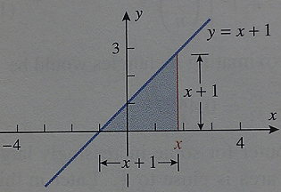
Confirming A’ = f(x) Using Geometry Examples
Example 1: Find the area A(x) between the graph of f(x)=x+1 and the interval [-1,x] and find the derivative A’(x) of this area function.
As you can see from looking at the graph, the area is a triangle and area A(x)=(1/2)base*height.
A(x)=(1/2)(x-(-1))(x+1)=(1/2)(x+1)(x+1)
=(1/2) x² + x + 1/2
The derivative of the area function above is
A’(x) = x+1 which is equal to the original f(x).
Therefore, A’(x) = f(x).

Slide 8
The Rectangle Method and the Antiderivative Method Compared
NOTE: There is a third geometry example on page 320 with a different line, and the antiderivative method works for higher degree polynomial functions and more sophisticated functions.
The rectangle method and the antiderivative method are very different approaches to solving the same problem of finding area.
The antiderivative method is usually quicker and more efficient.
The rectangle method makes more sense intuitively and we will use a similar method to find volume, length of a curve, surface area, etc.

Slide 9
Introduction
In the last section we saw how antidifferentiation could be used to find exact areas. In this section we will develop some fundamental results about antidifferentiation.
For example, F(x) = 1/3 x³ is an antiderivative “F” of f(x) = x² because the derivative of F(x) is F’(x) = x² = f(x).
The problem is that F(x) = 1/3 x³ is not the ONLY antiderivative of f(x).

Slide 10
The Problem with the Previous Example
If we add any constant C to 1/3 x³ , then the function G(x) = 1/3 x³ + C is also an antiderivative of f(x) since the derivative of G(x) is G’(x)= x² + 0 = f(x)
For example, take the derivatives of the following: F(x) = 1/3 x³ - 5, F(x) = 1/3 x³ +1/4, F(x) = 1/3 x³ +1, F(x) = 1/3 x³ +7, etc.

Slide 11
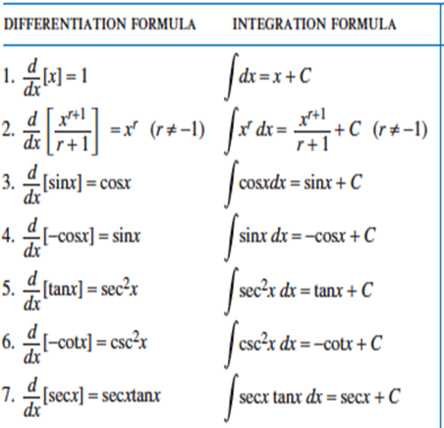
Integration Formulas
Here are some examples of derivative formulas and their equivalent integration formulas:
The integration
formula is just
“backwards”
when compared to
the derivative
formula you know.

Slide 12
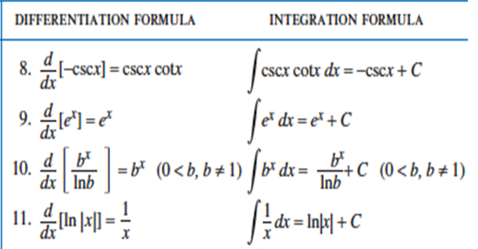
Integration Formulas
Here are more examples of derivative formulas and their equivalent integration formulas:
When you need to refer
back to these (you
probably will need to
quite often), you will
find the list on pg 324.
You might want to mark
it with a post-it.

Slide 13
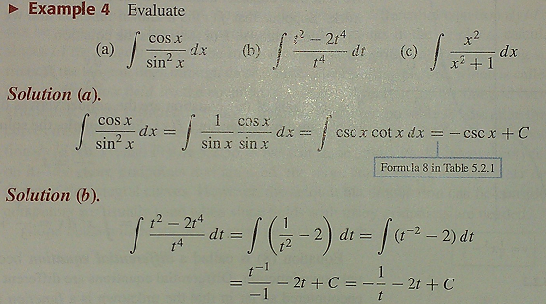
Consider Simplifying First
Sometimes it is useful to rewrite an integrand (the thing you are taking the integral of) in a different form before performing the integration.
Examples:

Slide 14
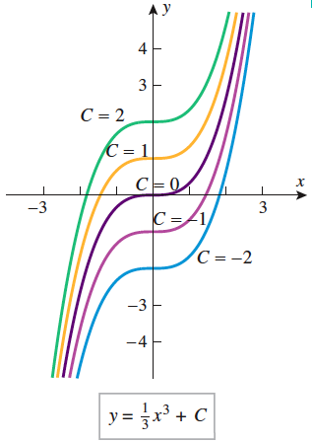
Integral Curves
As we discussed on slide #4, any of these curves could be the integral (antiderivative) of f(x) = x² because we do not know what the value of C is.

Slide 15
Initial Condition
When an “initial condition” is introduced, such as a requirement that the graph pass through a certain point, we may then solve for C and find the specific integral.
Example: Instead of finding that the integral of f(x) = x² is F(x) = 1/3 x³ + C, if we were given that the graph passes through the point (2,1) we could solve for C: 1 = 1/3 (2)³ + C
This gives us 1=8/3 + C so C=-5/3 and our anti-derivative is more specific:
F(x)=1/3 x³ -5/3

Slide 16
Slope Fields
If we interpret dy/dx as the slope of a tangent line, then at a point (x,y) on an integral curve of the equation dy/dx=f(x), the slope of the tangent line is f(x).
We can find the slopes of the tangent lines by doing repeated substitution and drawing small portions of the tangent lines through those points.
The resulting picture is called a slope field and it shows the “direction” of the integral curves at the gridpoints.
We can do it by hand, but it is a lot of work and it is more commonly done by computer.

Slide 17
Example

Slide 18
Introduction
In this section we will study a technique called substitution. It can often be used to transform complicated integration problems into simpler ones.
This method is directly related to the chain rule that we learned in chapter three for taking the derivative of a composition of functions f(g(x)).

Slide 19
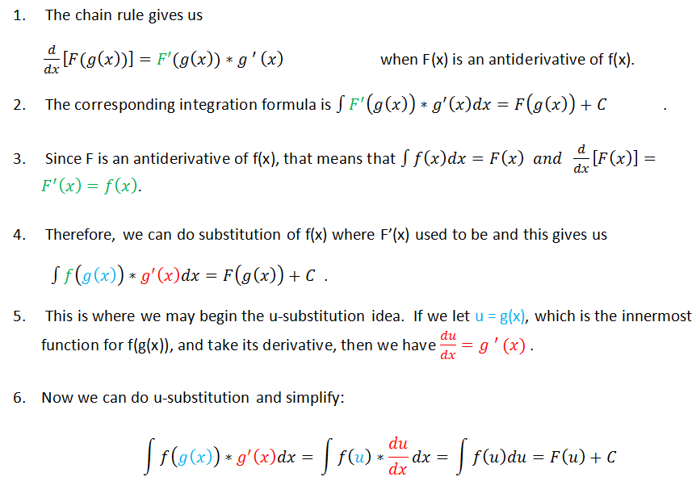
Relationship to the Chain Rule

Slide 21
Example
I picked x²+1 to be u because it is the “innermost function” and its derivative du/dx=2x which is also in the original problem and will make substitution easier.

Slide 22
Rules for Choosing u
There is no rule for how to pick u that works 100% of the time.
If you are starting with a composition of functions f(g(x)), setting u=g(x) will almost always work and that is a good thing to look for.
Another strategy that often works well is to look for two parts of the original question where one part is the derivative of another. Make one du/dx and the other equal to u.

Slide 23
Example of f(g(x))

Slide 24
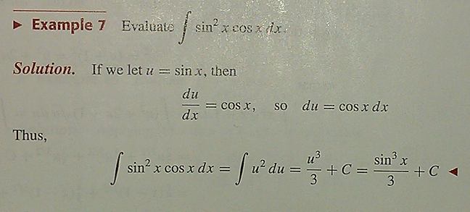
Example when a function and its derivative are both in the question:
The derivative of sin x is cos x and this original question has both. That often signals that we should make u = sin x and du/dx = cos x to make substitution work.

Slide 25
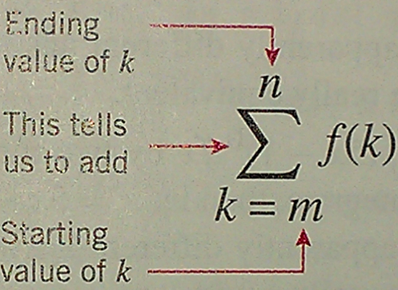
Introduction
Our main goal in this section is to use the rectangle method we discussed in section 5.1 to give a precise mathematical definition of the “area under a curve”.
You probably remember sigma notation from Algebra II or PreCalculus. We use the Greek letter sigma to denote sums:
m is called the lower limit of summation and n is called the upper limit of summation. k is called the index of summation and some books use different letters.

Slide 26
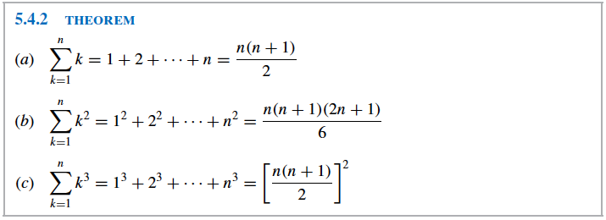
Summation Formulas

Slide 27
A Definition of Area
The distance between a and b is b-a.
Since we divided that distance into n subintervals, each is :
In each subinterval, draw a rectangle whose height is the value of the function f(x) at an arbitrarily selected point in the subinterval (a.k.a. x_{k}*) which gives f(x_{k}*).
Since the area of each rectangle is base * height, we get the formula you see on the right for each rectangle:
Area=
b*h = x * f(x_{k}*) = f(x_{k}*) x .

Slide 28
A Definition of Area - continued
Remember, that was the area for each rectangle. We need to find the sum of the areas of all of the rectangles between a and b which is why we use sigma notation.
As we discussed in a previous section, the area estimate is more accurate with the more number of rectangles used. Therefore, we will let n approach infinity.

Slide 29
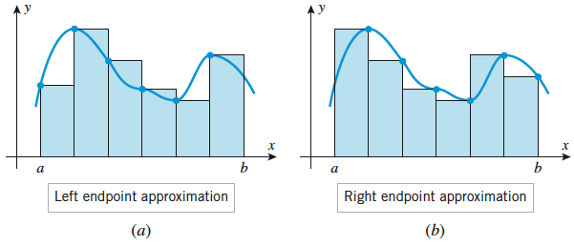
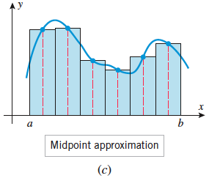
Choices for x_{k}*
x_{k}* can be chosen arbitrarily, but for this year we will either choose each to be the left endpoint of each subinterval, the right endpoint of each subinterval, or the midpoint of each subinterval.
You can see what that looks like in the following graphs:

Slide 30
How our choice of x_{k}* affects these problems:
Keep this list handy so that you know what to substitute in for x_{k}* depending upon whether you are using the left endpoint, right endpoint, or midpoint (they are on page 345 in your book).

Slide 31
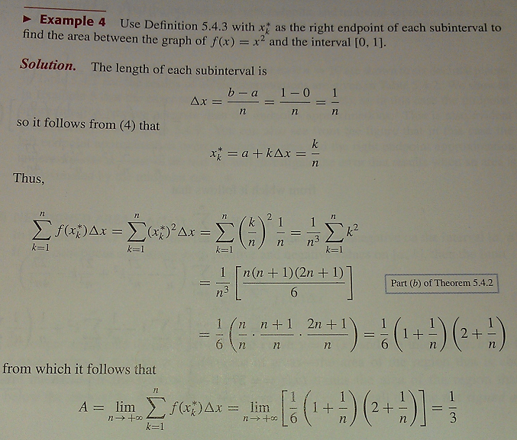
Example of how to use all of this information:

Slide 32
Other Helpful Limits
These formulas will often help to make the solution shorter.

Slide 33
Net Signed Area
Net signed area takes into account whether the area(s) is above or below the x-axis.
To find the total area instead, you will have to break the area up into portions that are above the x-axis vs. those that are below the x-axis and find each area separately. After taking their absolute values, you may then add them together (see picture on next slide).

Slide 34
Net Signed Area Example

Slide 35
Riemann sum
The sums we have been working with are called Riemann sums and the definite integral is sometimes called the Riemann integral in honor of the German mathematician Bernhard Riemann (1826-1866).
He formulated many of the basic concepts of integral calculus and we will use Riemann sums to help us find volume, surface area, and arc length in Chapter Six.
NOTE: Although a function does not have to be continuous on an interval to be integrable (able to be integrated) on that interval, we will generally be taking the definite integrals of continuous functions.

Slide 36
The Definite Integral

Slide 37
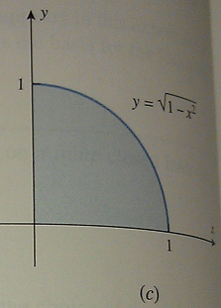
Partial Circle Example
Many people do not recognize this as a circle since it is not in graphing form. You may want to square both sides and add x² to both sides.

Slide 38
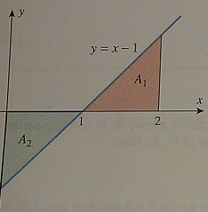
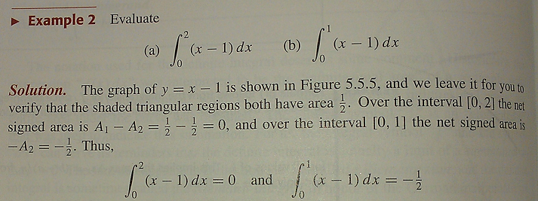
Net Signed Area – Another Example
We briefly discussed net signed area in
Section 5.4. Here is another example:
The area of the pink shaded region is 1/2 since Area₁= A₁=(1/2)b*h=(1/2)(1)(1)=1/2
The area of the green shaded region is -½ since Area₂= A₂=(1/2)b*h=(1/2)(1)(1)=1/2 and it is below the x-axis so it is negative.

Slide 39
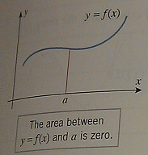
Properties of Definite Integrals
This property makes sense if you look at the figure to the right. Between the limits of integration (from a to a) there is no area under the curve y=f(x). Therefore, it equals zero.

Slide 40
More Properties of Definite Integrals
This property makes sense when you think of the earlier circle example and reverse the limits of integration (a and b):

Slide 43
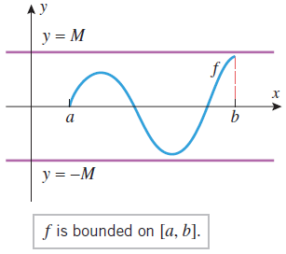

Slide 44
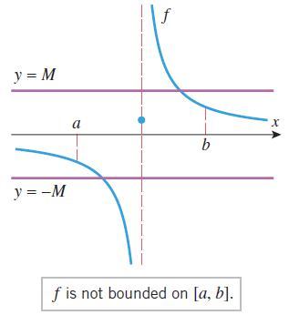

Slide 45
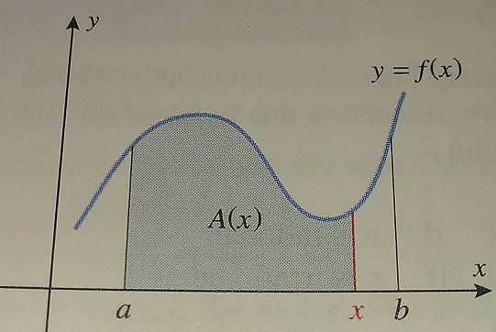
Developing The Fundamental Theorem of Calculus
We have already seen this area formula in section 5.5:
In section 5.1, we discussed that if A(x) is the area under the graph of f(x) from a to x, then
A’(x) = f(x).
We also discussed that the area under the curve from a to a is the area above the single point a, which is zero (see graph above right). A(a) = 0.
A(b) = A which is the area we are trying to find under the curve from a to b (see graph below rt)
Since A’(x) is an antiderivative of f(x), every other antiderivative of f(x) on [a,b] can be obtained by adding a constant to A(x) which we have already discussed: F(x) = A(x) + C

Slide 46
The Fundamental Theorem of Calculus
Using F(x) = A(x) + C from the previous slide, we can calculate F(a) and F(b) and consider what happens when we subtract them:
F(b) – F(a) = [A(b)+C] – [A(a)+C]
= A(b) + C – A(a) – C
= A(b) – A (a) = A – 0 = A
In words: The definite integral can be evaluated by finding any antiderivative of the integrand f(x) and then subtracting the value of this antiderivative at the lower limit of integration from its value at the upper limit of integration.

Slide 47
The Fundamental Theorem of Calculus

Slide 48
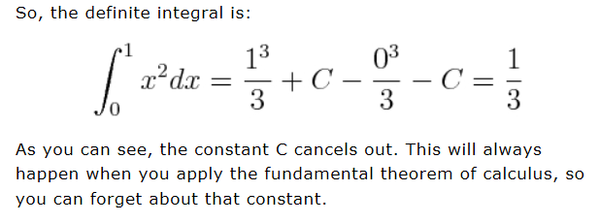
Example 1

Slide 49
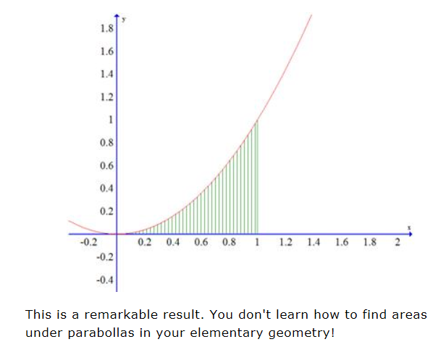
Example 1 Results
The integral we just calculated gives us the area in the picture below which is 1/3.

Slide 50
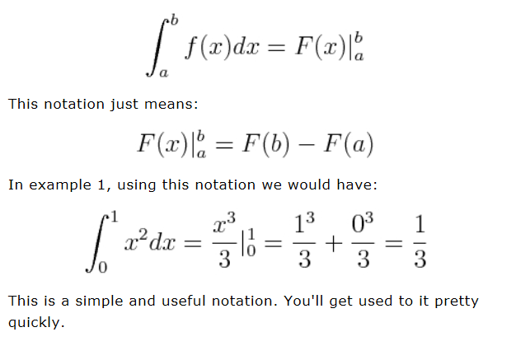
Notation
The formula that The Fundamental Theorem of Calculus gives us is usually written with a special notation.

Slide 51
Warning
The requirements listed with the Fundamental Theorem of Calculus that the function f must be continuous on [a,b] and that F is an antiderivative of f on [a,b] are important to keep in mind.
Disregarding these rules will often lead to incorrect results.
Also, note that the Fundamental Theorem of Calculus can be applied without any changes when the lower limit of integration is greater than or equal to the upper limit of integration (see example #6 on page 366 if you have a question).

Slide 52
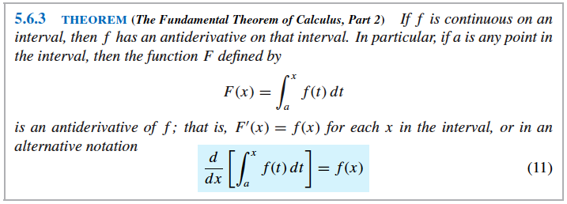
Fundamental Theorem of Calculus Part Two

Slide 53
Fundamental Theorem of Calculus Part Two in Words
If a definite integral has a variable upper limit of integration, a constant lower limit of integration, and a continuous integrand f(x), then the derivative of the integral with respect to its upper limit is equal to the integrand f(x) evaluated at the upper limit.

Slide 54
Example
Short way
Long way

Slide 55
Differentiation and Integration are Inverse Processes
When you put the two parts of the Fundamental Theorem of Calculus together, they show that differentiation (taking the derivative) and integration (taking the integral) are inverse processes (they “undo” each other).
It is common to treat parts 1 and 2 of the Theorem as a single theorem and it (formulated by Newton and Leibniz) ranks as one of the greatest discoveries in the history of science and the “discovery of calculus”.

Slide 56
Integrating Rates of Change
If you write the Fundamental Theorem of Calculus in a slightly different form,
it has a useful interpretation.
Since F’(x) is the rate of change of F(x) with respect to x and F(b) – F(a) is the change in the value of F(x) as x increases from a to b:

Slide 57
Applications of Integrating Rates of Change

Slide 58
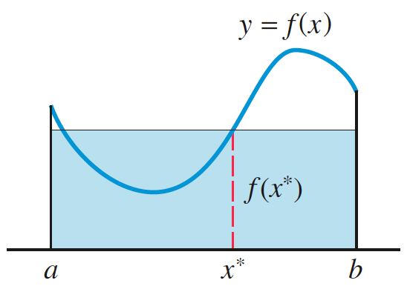
The Mean-Value Theorem for Integrals
To help better explain why continuous functions have antiderivatives, we need to use the concept of the “average value” of a continuous function over an interval.
We look for a value of x (x*) where the area of the shaded rectangle will equal the area under f(x) between a and b.
We find that value of x using the following:

Slide 59
Example

Slide 60
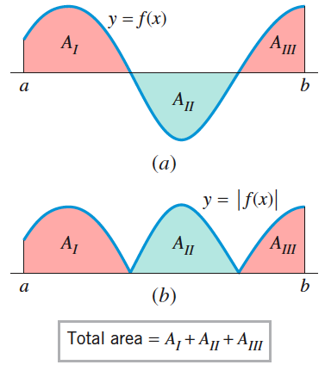
Total Area
First divide the interval into subintervals on which f(x) does not change sign (see diagram).
Calculate the absolute value of the area of each subinterval and add the results.
We will do more of these in section 5.7.

Slide 61
Introduction
In Section 4.6 we used the derivative to find velocity and acceleration for a particle in rectilinear motion.
v(t) = s’(t) and a(t) = v’(t) = s”(t)
In this section, we will use the integral to reverse the process.

Slide 62
Example

Slide 63
Computing Displacement by Integration
Since displacement is final position minus initial position, it can be written as follows in integral form:
This is a special case of a form of the Fundamental Theorem of Calculus from section 5.6:

Slide 64
Computing Distance Traveled by Integration
Distance traveled is different than displacement because it is the total of all of the distances traveled in both positive and negative directions.
Therefore, we must integrate the absolute value of the velocity function:
NOTE: Integrating velocity over a time interval produces displacement, and integrating speed over a time produces distance traveled.

Slide 65
Example
Use a and b as given in question.
First determine where the particle turns around, then use Theorem 5.5.5 to break into parts.

Slide 66
Analyzing the Velocity vs. Time Curve
As you hopefully saw in the last example, the integral is the “net signed area” under the velocity curve v(t) between time zero t₀ and time one t₁ (see graph on next slide) which gives you displacement.
The “total area” under v(t) between those times gives you distance traveled.

Slide 67
Distance Traveled vs. Displacement
Notice the sign change on A₂ for distance traveled.

Slide 68
Constant Acceleration
When acceleration is constant, we can work backwards to find formulas for position and velocity as long as we know the position and velocity at some point in time.
Example: Suppose that an intergalactic spacecraft uses a sail and the “solar wind” to produce a constant acceleration of 0.032 m/s² (a = .032). Assuming that the spacecraft has a velocity of 10,000 m/s (v(0) = 10,000) when the said is first raised, how far will the spacecraft travel in 1 hour?
NOTE: s(0) = 0
Remember:
Therefore, v(t) = .032t + C which is the integral of accel.
10,000 = .032 (0) + C so C = 10,000 gives
v(t) = .032t + 10,000 and
s(t) = .032t²/2 + 10,000t + C₂ the integral of v(t)
0 = .016(0)² + 10,000(0) + C₂ so C₂ = 0 gives
s(t) = .016t² +10,000t and since 1 hour = 3600 sec
s(3600) = .016(3600)² + 10,000(3600) is apprx 36,200,000 meters

Slide 69
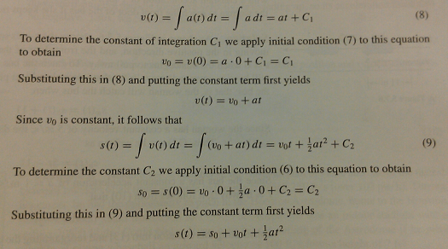
General Case of Constant Acceleration
We can use the same method from the previous example to find general formulas for velocity and position when acceleration is constant by integrating acceleration:

Slide 70
Free-Fall Model
Motion that occurs when an object near the Earth is imparted some initial velocity (up or down) and thereafter moves along a vertical line is called free-fall motion.
We assume the only force acting on the object is the Earth’s gravity which is constant (when sufficiently close to Earth). NOTE: We are disregarding air resistance and gravitational pull from the moon, etc. for now.
A particle with free-fall motion has constant acceleration in the downward direction (9.8 meters/second² or 32 feet/second²).
Therefore, the formulas developed on the previous slide apply and a = -acceleration due to gravity (g).

Slide 72
Examples
There are examples on page 381 that my be helpful.
They are similar to the spacecraft example, but include gravity.

Slide 73
******MISSING******* 5.8
NOTE: SECTION 5.8 IS MISSING. FINISH NOTES AND PUT IT HERE.
Sorry, I did not have time. We will go over 5.8 soon in class.

Slide 74
Two Methods for Making Substitutions in Definite Integrals
Method 1: You can do the entire u-substitution process to get the integral, re-substitute the x portion back in for u, then use the given upper and lower limits of integration to evaluate the definite integral as we did previously:
Method 2: You can start the u-substitution process and rewrite the entire integral in terms of u. After that, you need to find u values that correspond to the given upper and lower limits of integration and evaluate the definite integral using those:

Slide 75
Example (pg 394 #40)
2

Slide 76
Example (pg 394 #40) by changing the limits of integration

Slide 77
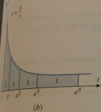
Connection Between Natural Logarithms and Integrals

Slide 78
Continuity and Differentiability Natural Logarithm Properties
Please read the bottom half of page 397 and the top part of page 398 regarding the our previous assumption that e^{x} is continuous and the resulting properties of logarithms.
Below are listed the product, quotient, and power properties from Algebra II and Pre-Calculus/Math Analysis in terms of the natural logarithm (proofs on pages 398-399):

Slide 79
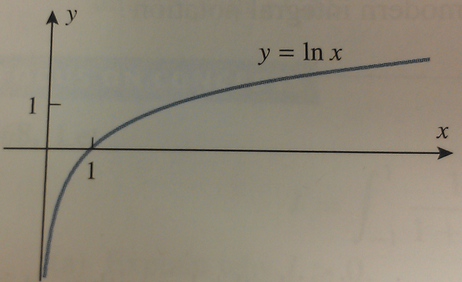
Graph, Domain, Range, and End Behavior of ln x

Slide 80
Definition and Derivative of e^{x}

Slide 81
Functions Defined by Integrals
The functions we have dealt with so far this year are called elementary functions: they include polynomial, rational, power, exponential, logarithmic, and trigonometric and all other functions that can be obtained from these by addition, subtraction, multiplication, division, root extraction, and composition.
There are many important functions that do not fall into this “elementary function” category which often result from solving initial value/condition problems of this form:
dy/dx = f(x) given y(x₀) = y₀

Slide 82
Solving Functions Defined by Integrals
The basic method for solving functions of this type is to integrate f(x), and then use the initial condition to determine the constant of integration C as we did in Section 5.2.
Instead, we could find a general formula (indefinite integral) for the solution and then apply that formula to solve specific problems.

Slide 83
Integrals with Functions as Limits of Integration
Various applications can lead to integrals in which at least one of the limits of integration is a function of x.
For now, we will differentiate (take the derivative of) these integrals only.
To do so, we will apply the chain rule:

Slide 84
Example

Slide 85
Who knows where this is?

